Slide 1
[Title] (wombo combo doesn’t work as good anymore)
[One-liner]

Slide 2
Narrative
Far in the future, all necessary services have been taken over by robots, and planetary travel has become a custom. With such a convenient society, the humans and aliens have lost track of what they want from life and what their purpose is. As depression spread into the vast galaxy, a sole entrepreneur finds a solution – a way for people to regain their lost motivation and energy. Within each and everyone of us is an mystery yet to be solved. Even those who spends millions of hours together won’t understand the depth of another creature perfectly, but they sure can strive to. This entrepreneur had an idea to create a sport, a battle within an arena where the understanding of your fellow teammates were the only way to achieve victory.
Fight together with your best alien and human friends in an arena in a battle to prove to the world your understanding of each other and get to know eachother better than ever before.

Slide 3
Gameplay
(Flowchart and KEY features)

Slide 4
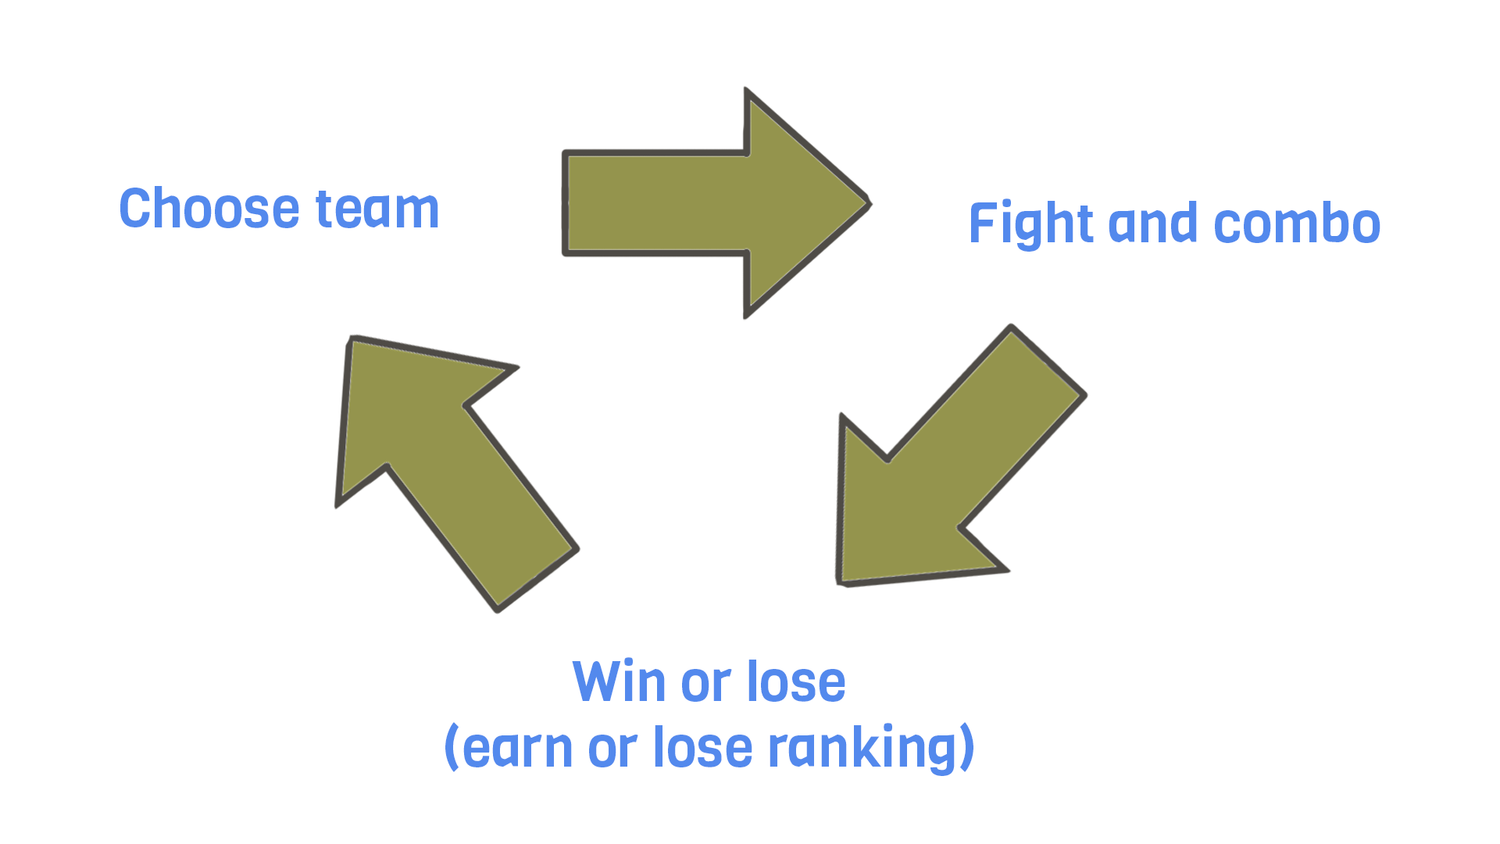
Flowchart

Slide 5
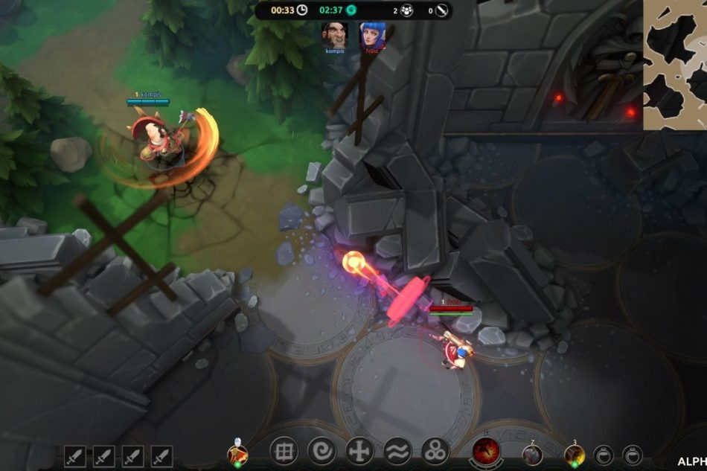
Gameplay
3v3 Arena Fighter
Top down RTS/moba view
Control a character with unique abilities
Play together with your two teammates to cover up their weaknesses and have them cover your own.
Win by depleting enemy team’s Team Spirit

Slide 6
Team Spirit
The health of the game
Win by reducing enemies’ team spirit to 0
You share team spirit with you teammates
Team spirit is gained by:
Hitting and combining skills
Sticking together with your teammates
Team spirit is lost by:
Getting direct hits from enemy smasher
Being apart from teammates

Slide 7
More Gameplay
All characters are invisible unless pinged by Settler or sensed by a burrowed Blocker.

Slide 8
What can I do?
Top-down walking around on 2 axises
Walk in different speed depending on how far you push the stick left stick
Aim abilities with right stick

Slide 9
Character 1 - Blocker -
Digs down to get enemy location through sensing vibrations
Has the ability to block enemy smash, but is unable to see it

Slide 10
Character 2 - Settler -
Has the ability to ping target location to grant the Smasher vision over that area
Has the ability to drag enemies in an area together into one spot

Slide 11
Character 3 - Smasher -
Can shoot out an energy orb in target direction. By pressing the ability button again a lighting will strike and reduce team spirit based on amount of targets hit.
Or
Lobs a rock by holding down ability button to increase distance traveled.

Slide 12
UI Navigation

Slide 13
Technicalities
And things I find boring

Slide 14
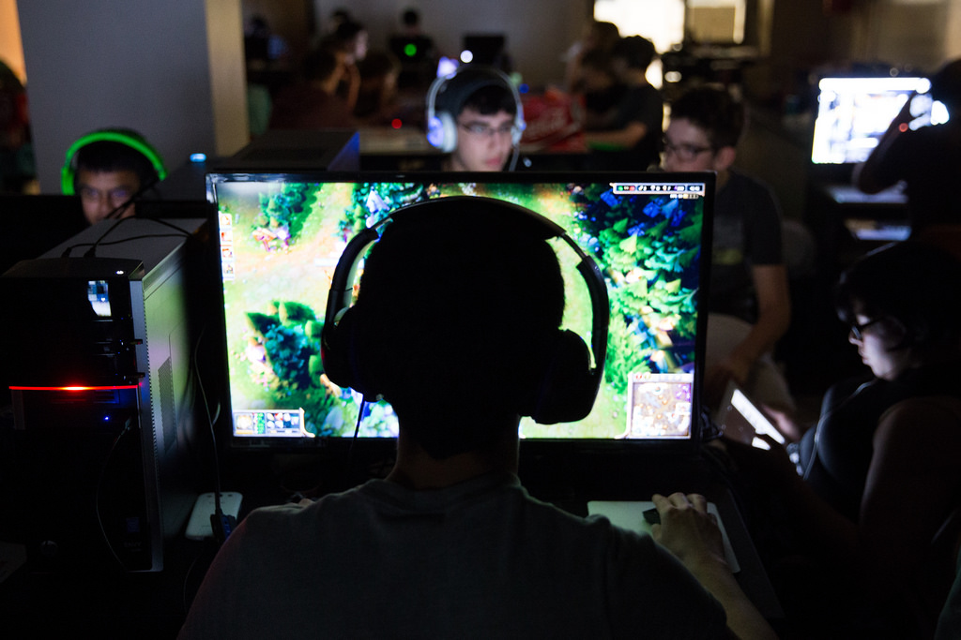
Audience
People that play mobas with friends but want a better way of expressing their teamwork than the long downtime fights that focus more on individual play rather than teamwork.
People that enjoy sports and the competitive feeling of team vs team.
PROBLEM: Mobas are not normally controller played games. Target audience might not have required hardware.
SOLUTION: Switch to keyboard and mouse for input?

Slide 15
Hardware
PC – Best played with controller????
^that’s just a bad idea, right?

Slide 16
Software
Game Engine: Unity or Unreal, whichever is better for networking.
Code: Visual Studio
Art: Substance Painter, Photoshop, 3DS Max, Motionbuilder
Others: Audacity, Vegas Pro (For trailers), OBS Studio (For recording gameplay)

